Slide 1
Warm Up: Safety
What does safety mean to you?
Please describe in 3-5 sentences

Slide 2
Safety

Slide 3
Basics
Risks? - potentially harmful chances
Follow basic safety rules
Don’t give in to peer pressure
Think before you act
Know your limits

Slide 4
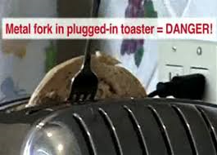
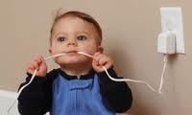
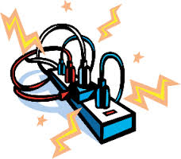
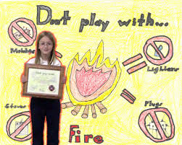
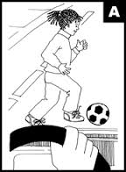
Safety
Home
Electrical
Fire
Street
Internet
Recreation

Slide 5
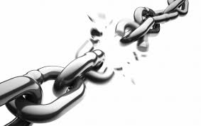
The Accident Chain
The Situation
The Unsafe Habit
The Unsafe Act
The Accident
The Results of the Accident

Slide 6
Safety at Home
Homes have hazards; possible sources of harm/danger
Example: Preventing Falls
Wipe up spills
Keep steps & stairways well lit and free of objects
Do not run on wet floors
Use a sturdy stepladder
Other Examples?

Slide 7
Electrical Safety
Do not use appliances/cords with frayed wires
Pull out plugs by the plug itself, not the wire
Use a surge protector
Keep electrical products
away from water
Don’t overload outlets

Slide 8
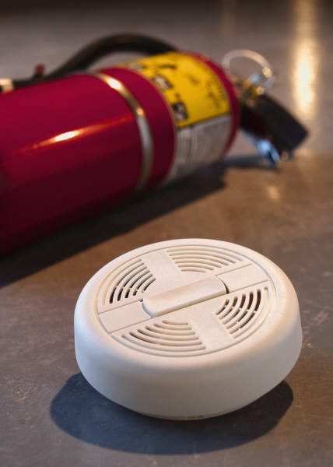
Fire Safety
Keep a fire extinguisher within reach
Always have a smoke alarm; a device that makes a warning noise when it senses smoke
Make sure to not smoke in the house (its bad to smoke anyway!)
Keep stoves clean
If a kitchen fire occurs smother
a grease fire with baking soda or
wet cloth

Slide 10
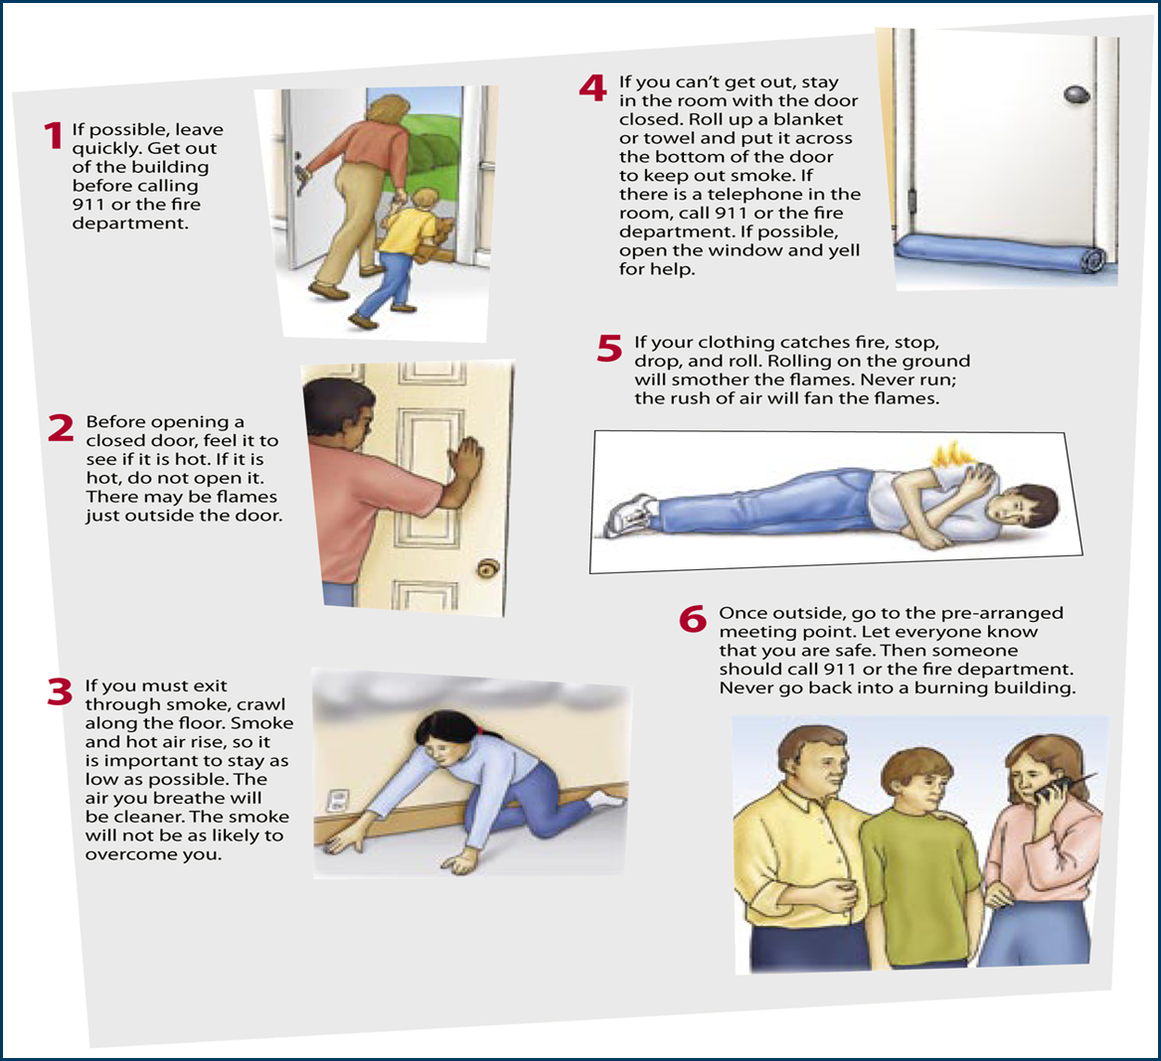
In case of a fire….

Slide 11
Street Safety
Follow Road Rules!
Cross streets at pedestrian intersections
Look before crossing
Obey traffic signals
Watch for cars turning right at red lights
Do not wear earphones while crossing the street
Biker should always wear a helmet, wear proper clothing, and ride single file

Slide 12
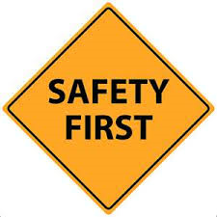

Slide 13
Internet Safety
Never trade personal photographs in the mail or scanned photographs over the Internet
Never reveal personal information, such as address, phone number, or school name or location. Use only a screen name. Never agree to meet anyone from a chat room in person.
Never respond to a threatening email or message.
Always tell a parent about any communication or conversation that was scary.

Slide 14
Exit Ticket
Think about 3 safety precautions you perform each day.
Create an emergency scenario that would include the 5 parts to the accident chain.
What does the acronym P.A.S.S. mean?
Why is it important to always use internet safety? ( two sentences)

